Slide 1
Design Patterns

Slide 2
What is Design Pattern ?
Why should we use design pattern?
How many design patterns are there ?

Slide 3
What is an abstract class ?
What is a difference between Interface and abstract class ?

Slide 4
FACTORY Pattern
In real life a factory is a place that produces things and usually this things are a family of things.
In Code a factory is something which creates a family of objects and we can have factory classes and factory methods in it

Slide 5

kitkart
This company wants you to write software for
Them and they produce computers for
Their clients

Slide 6
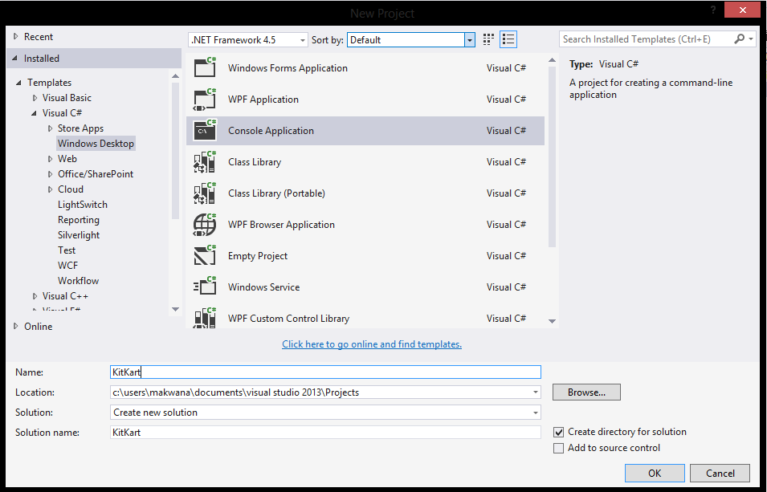

Slide 7
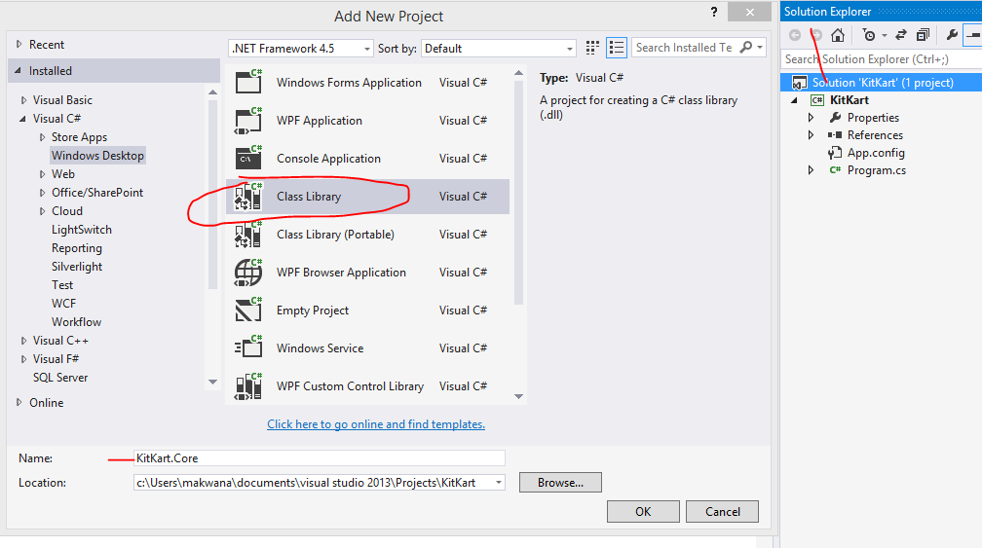

Slide 8
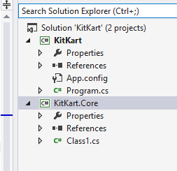

Slide 9
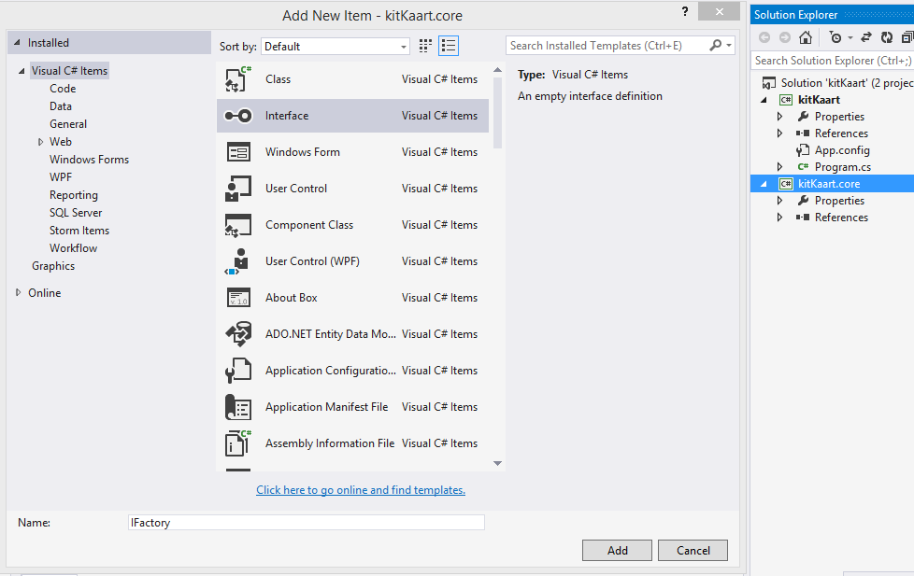

Slide 10
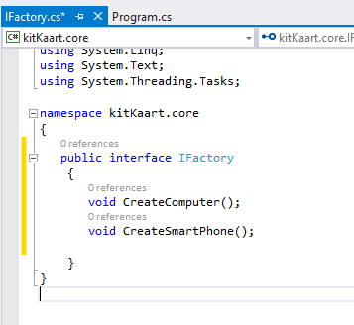


Slide 11
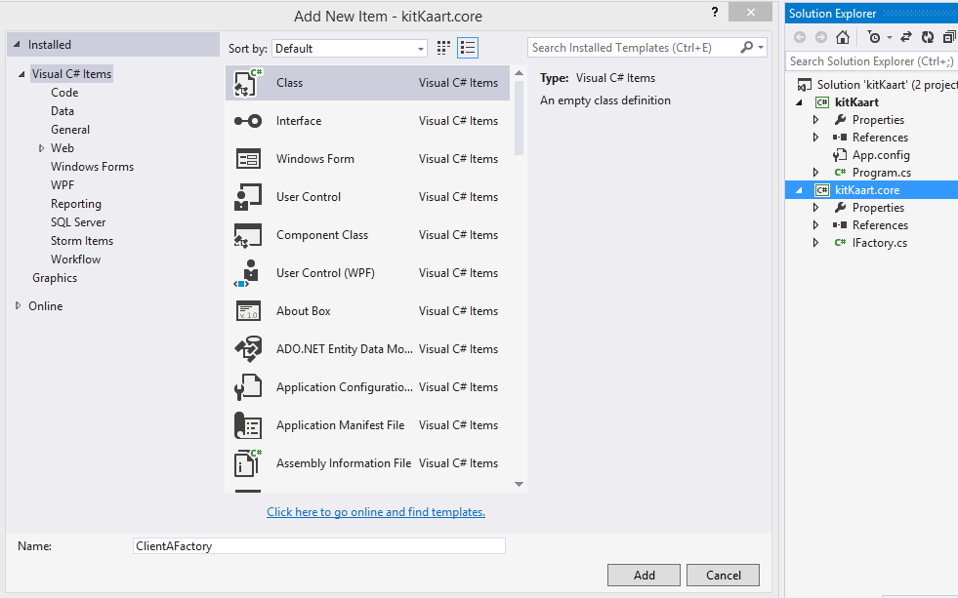

Slide 12
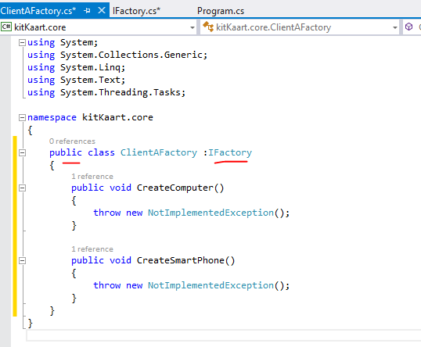

Slide 13
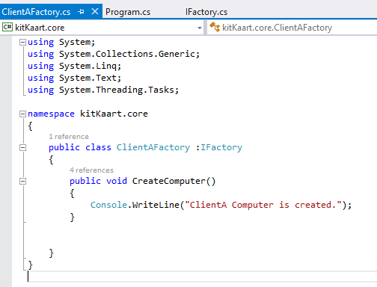
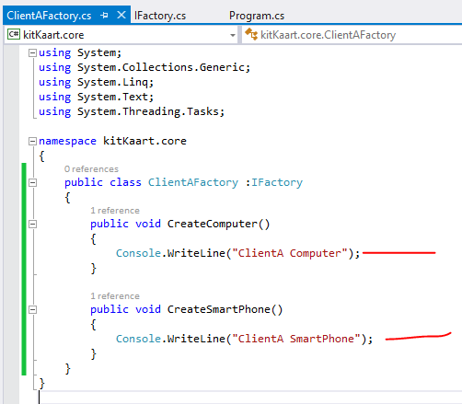

Slide 14
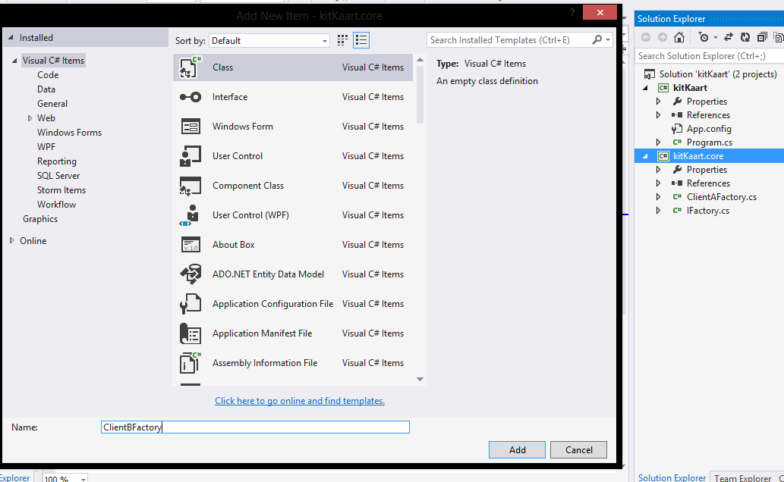

Slide 15
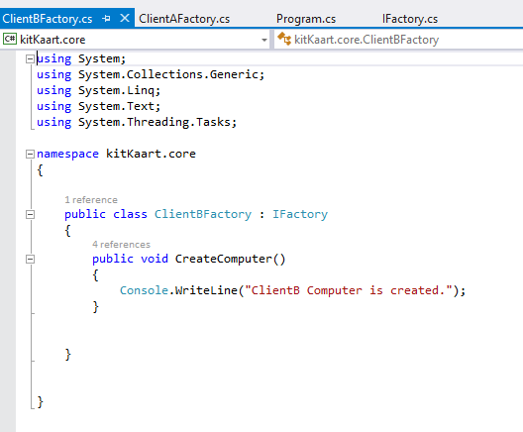
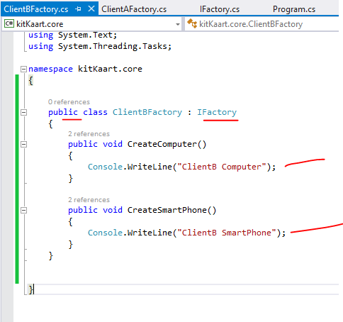

Slide 16
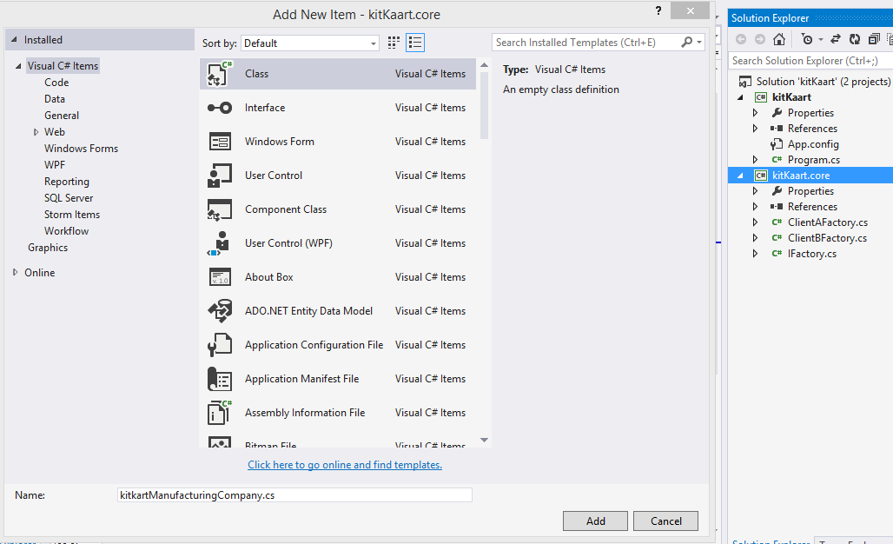

Slide 17
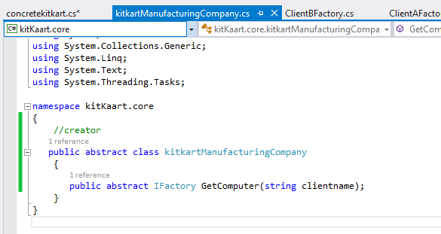

Slide 18
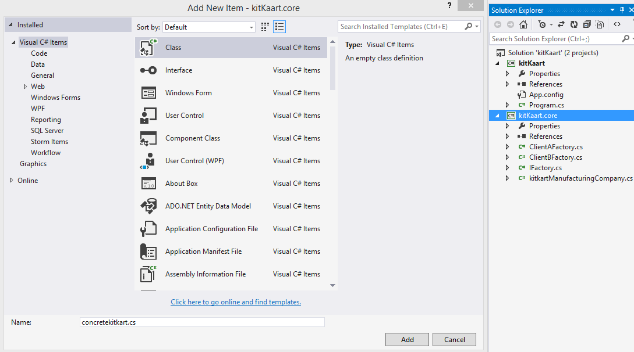

Slide 19
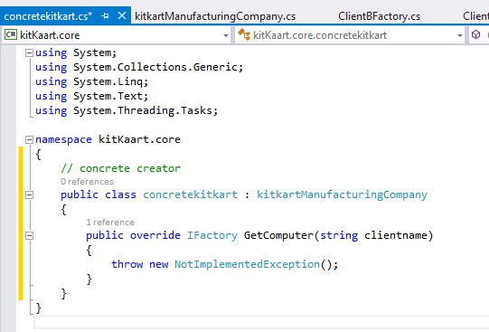

Slide 20
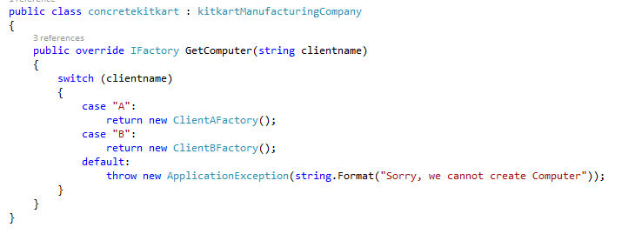

Slide 21
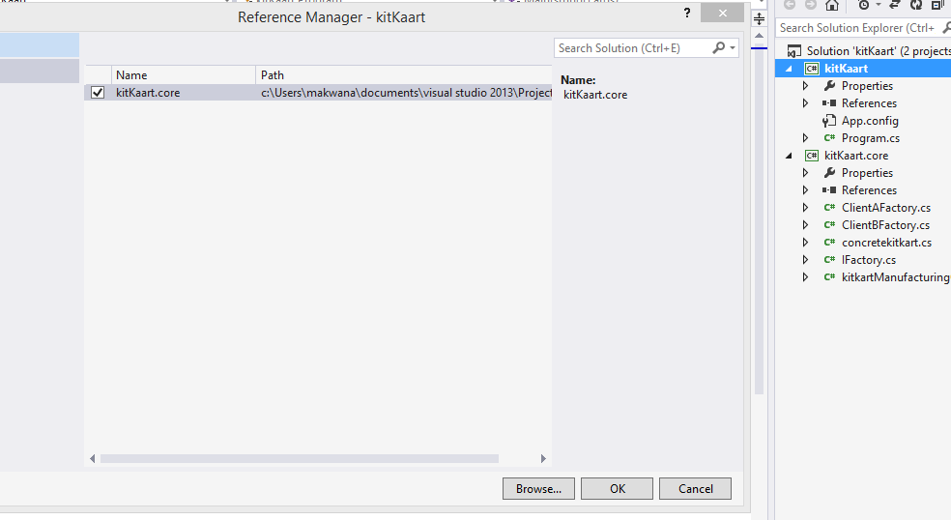

Slide 22
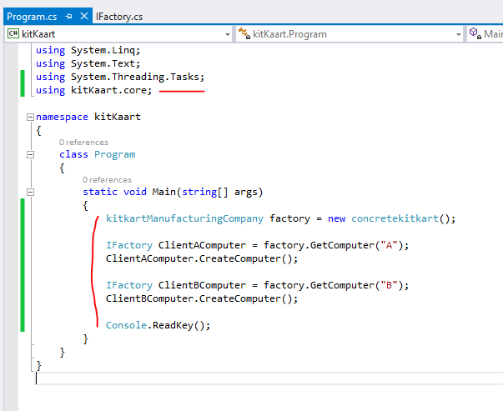

Slide 23
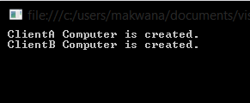

Slide 24
ClientAFactory
IFACTORY
ClientBFactory
kitkartManufacturingCompany
concretekitkart

Slide 25
Now in real life when there are complex code are
required there is a better way to create
Factory pattern

Slide 26
Abstract FACTORY Pattern
Abstract Factory patterns acts a super-factory which creates other factories.
This pattern is also called as Factory of factories. In Abstract Factory pattern an interface is responsible for creating a set of related objects, or dependent objects without specifying their concrete classes.

Slide 27
kitkart
This company wants you to write software for
Them and they produce three products for
Multiple clients
Computers
Tablets
Phones

Slide 31
First let’s create some data types for our products [Computers, phones, tablets] and we want this as abstract as possible
So we are going to use Interfaces for that

Slide 32
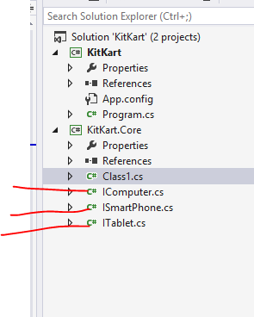
Add three new
interfaces
with these names

Slide 33
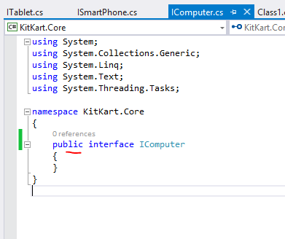
Make sure all
interfaces are public

Slide 34
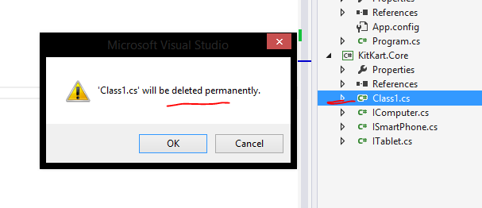

Slide 35
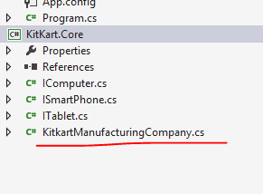
Add a new class

Slide 36
Actually we are going to have multiple clients for this manufacturing company
For now assume that we have 2 clients
Client A and Client B

Slide 37
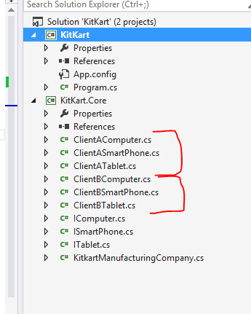

Slide 38
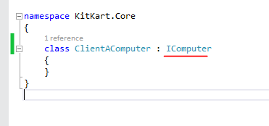
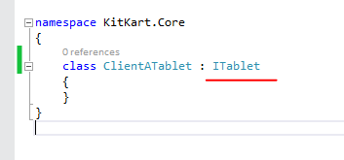
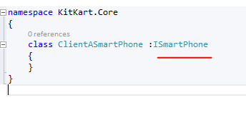
All clientA classes
are implementing interfaces
Do same for ClientB also

Slide 39
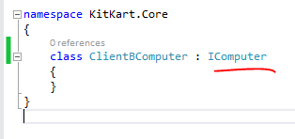
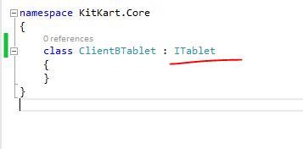
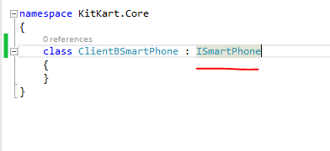

Slide 40
Now I want to create a factory which will produce products for my clients

Slide 41
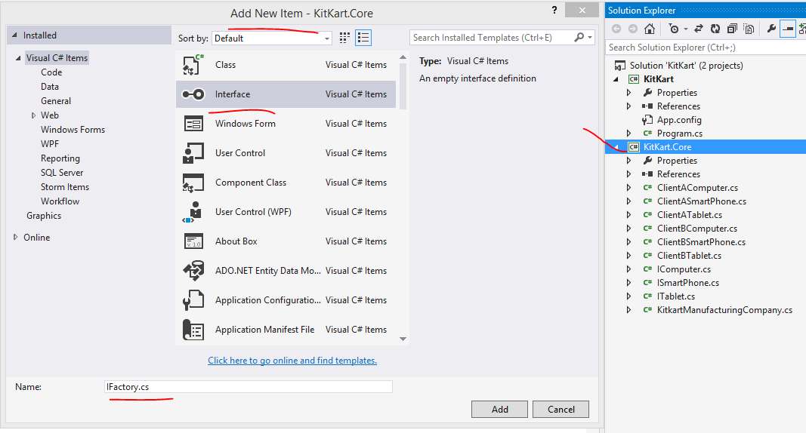

Slide 42
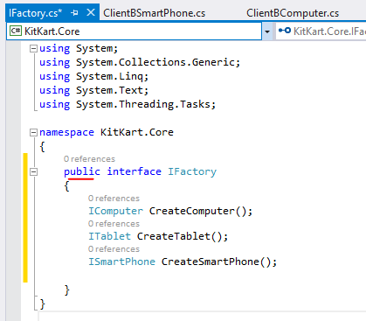
In this public interface
We have created
three methods which returns
of type matching
with our interfaces

Slide 43
Everytime when we have interface and
We want to use it we need to
implement it in a class
So…

Slide 44
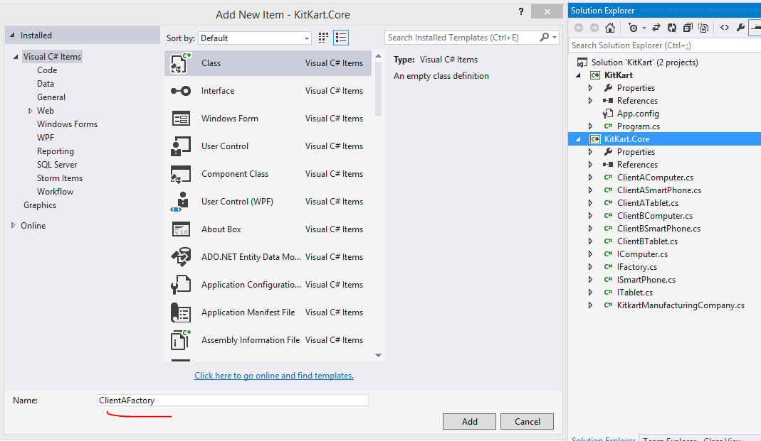

Slide 45
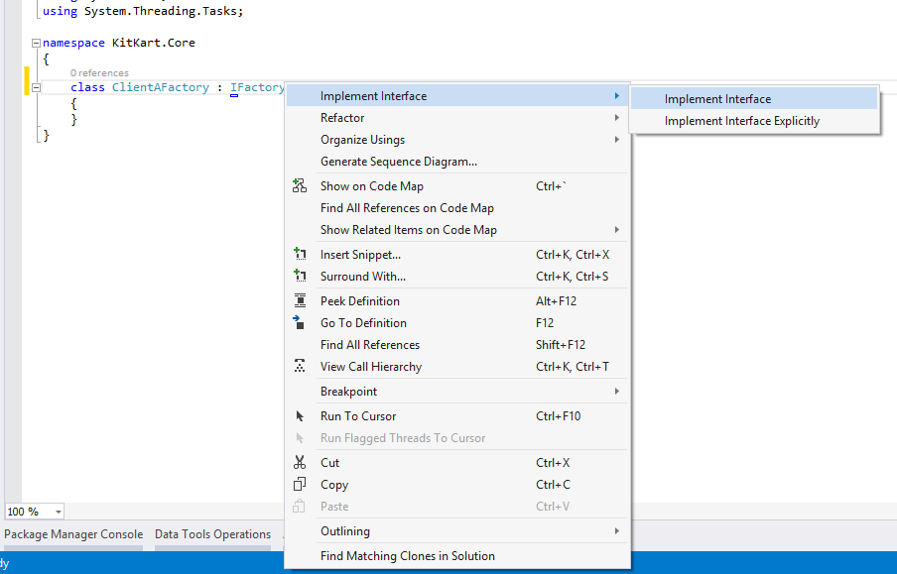

Slide 46
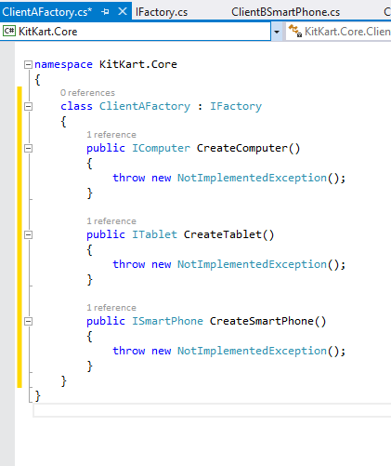

Slide 47
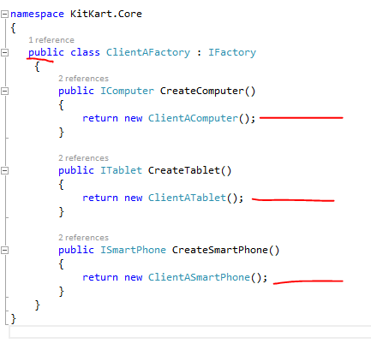
Do same for ClientB also

Slide 48
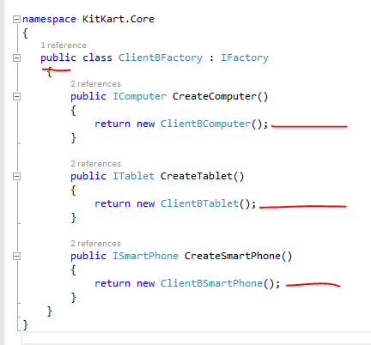

Slide 49
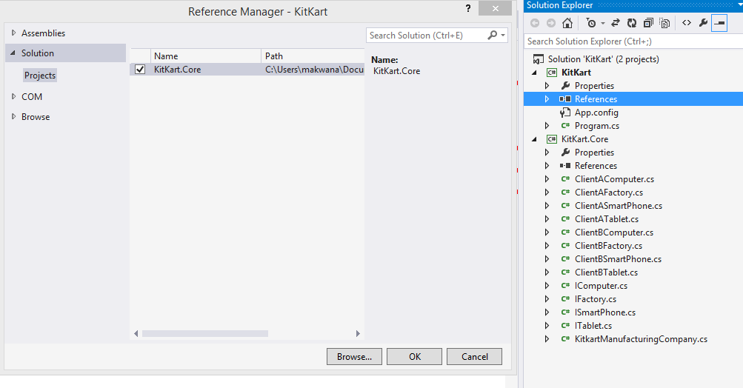
Add reference

Slide 50
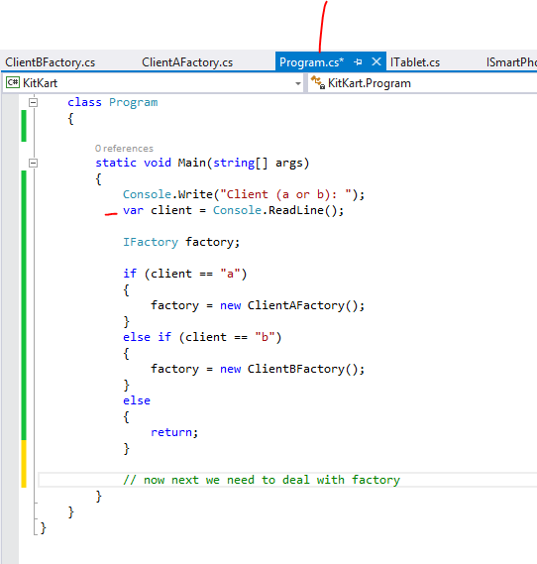
Now we are trying to get user input
Once we will get client from this
We will use it with factory

Slide 51
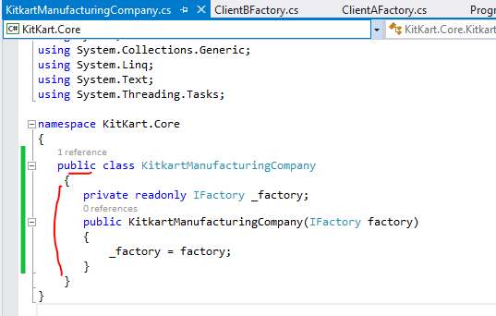

Slide 52
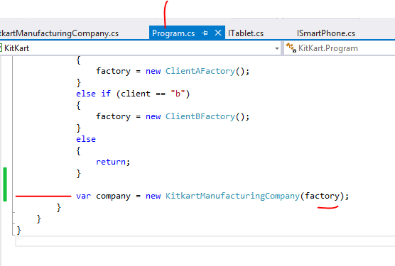
This company we will use later

Slide 53
Next we need to deal with orders
From both the clients
So,….

Slide 54
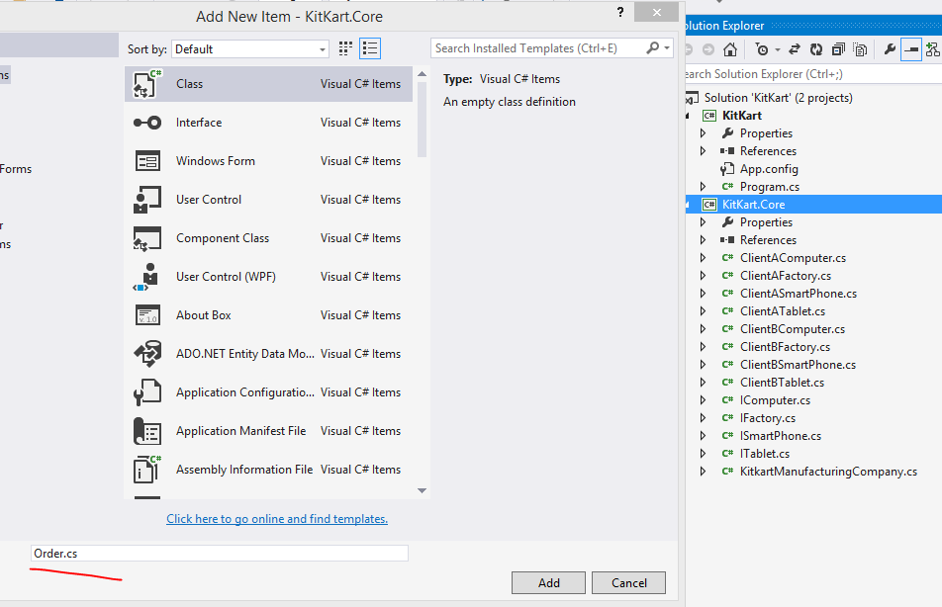

Slide 55
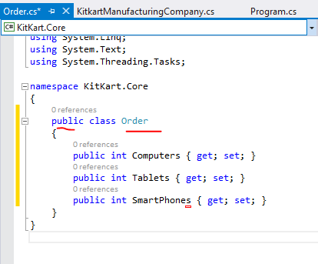
Each order can take number for each of these products

Slide 56
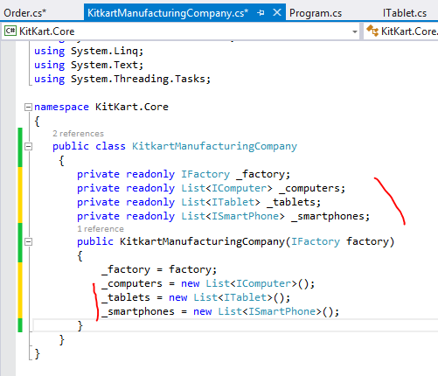
Here we are creating
Three collections
in which we keep the
Products we are creating

Slide 57
Now let’s expose our computers,
tablets, and phones as a public properties
These properties will allow only get
so our actual list will be still protected

Slide 58
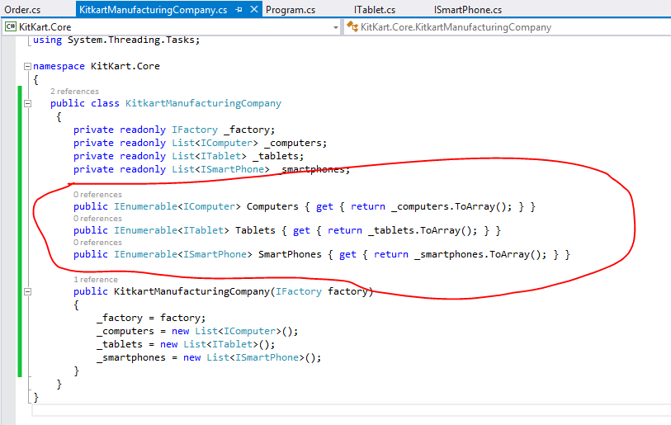

Slide 59
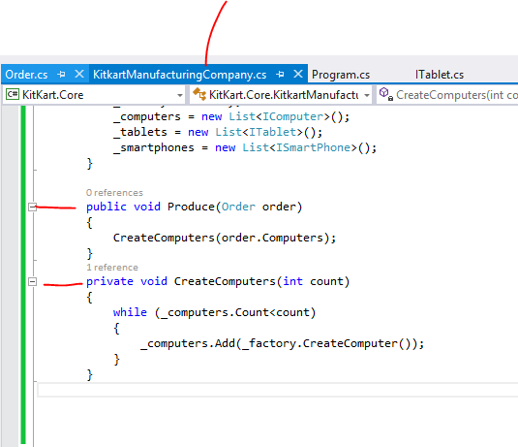

Slide 60
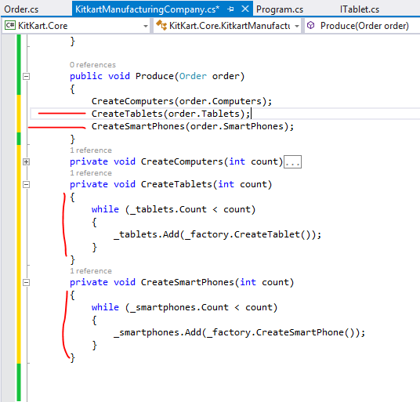
Same way

Slide 61
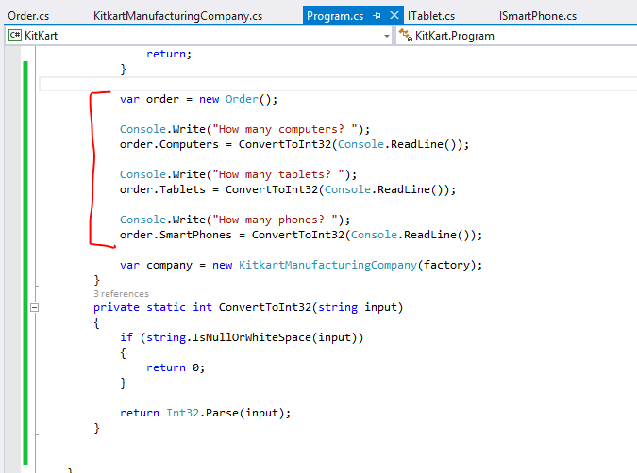

Slide 62
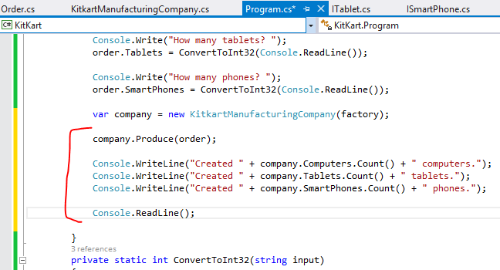

Slide 63


Slide 64
ClientAComputer
ClientASmartphone
ICOMPUTER
ClientATablet
ClientAFactory
ISMARTPHONE
IFACTORY
ClientBFactory
ClientBComputer
ITABLET
ClientBSmartphone
DI
ClientBTablet
order
kitkartManufacturingCompany

Slide 65
Factory pattern gives us a clean API for creating
Similar types of Objects
Real life :
MVC framework creates a controller using a factory

